Slide 1
Digital Electronics and Systems

Slide 2
In this lecture you will learn:
Analog systems vs. digital systems.
Variables and functions
Truth table

Slide 3
Introduction
Electronic Circuits
Digital Circuits
Analog Circuits
An analog quantity is one having continuous values.
Digital quantity is one having a discrete set of values.

Slide 4
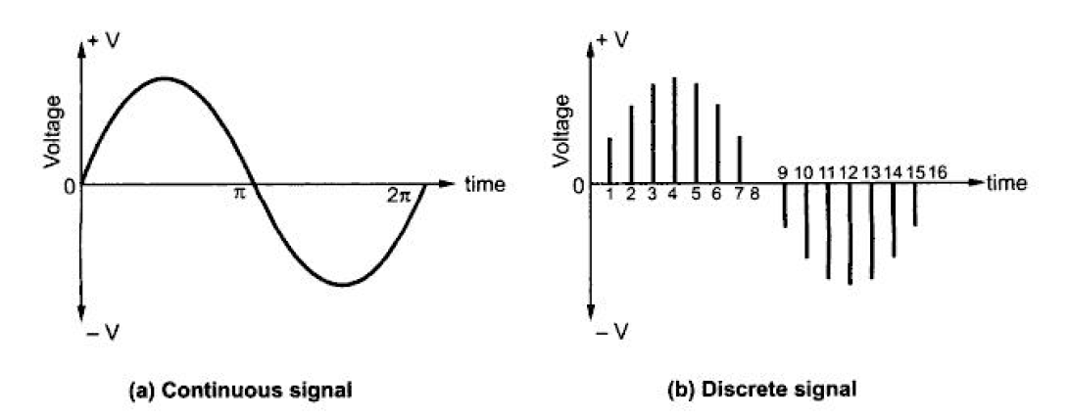
In digital representation each point will be represented by a series of 1s and 0s.
Such two value representation is known as binary representation.

Slide 5
Advantages of digital systems over analog systems
Digital systems are easier to design.
Information storage is easy.
Accuracy and precision are greater.
Digital circuits are less affected by noise (unwanted signal).

Slide 6
Disadvantages of digital systems over analog systems
“The real world is Analog”
Most physical quantities are analog in nature.
So we use a lot of analog inputs and convert them into digital, process it and reconvert to analog output.
Because of these conversions, the processing time increases and the system become more complex.
In most cases, these disadvantages are outweighed by numerous advantages of digital techniques.

Slide 7
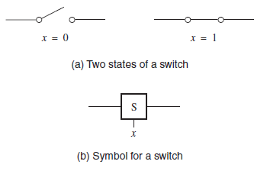
Variables and Functions
The simplest binary element is a switch that has two states: ON and OFF.
Consider, a variable ‘x’ is controlling the switch.
x =0 | Switch is open
x = 1 | Switch is closed

Slide 8

Input - variable ‘x’ (switch control)
Output – state or condition of the light, L
Light is ON L =1
Light is OFF L =0
Using this convention, state of the light as a function of the input variable x.
L =1 if x = 1
L =0 if x =0
L(x) = x , this is the simple logic expression describes the output (L) as a function of the input (x).

Slide 9
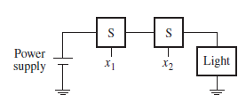
Let’s consider different cases.
Case 1: Switches are connected in series.
x1 & x2 Control Inputs for switches
Using a series connection, the light will be turned on only if both switches are closed.
If either switch is open, the light will be off.

Slide 10
This behavior can be described by the expression
L(x₁, x₂) = x₁ · x₂
where L = 1 if x₁ = 1 and x₂ = 1,
L = 0 otherwise.
The “.” symbol is called the AND operator.

Slide 11
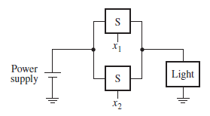
Case 2: Two switches are connected in parallel.
In this case the light will be ON if either the x₁ or x₂ switch is closed.
The light will also be ON if both switches are closed.
The light will be OFF only if both switches are open.

Slide 12
This behavior can be stated as:
L(x₁, x₂) = x₁ + x₂
where L = 1 if x₁ = 1 or x₂ = 1 or if x₁ = x₂ = 1,
L = 0 if x₁ = x₂ = 0
The “+” is called the OR operator.

Slide 13
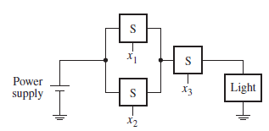
Case 3: Series – parallel connection
L(x₁, x₂, x₃) = (x₁ + x₂) · x₃
The light is on if x₃=1 and, at the same time, at least one of the x₁ or x₂ inputs is equal to 1.

Slide 14
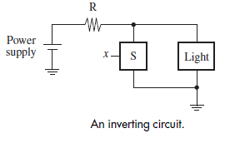
Inversion
In this case the switch is connected in parallel with the light, rather than in series.
Consequently, a closed switch will short-circuit the light and prevent the current from flowing through it.
Note: An extra resistor in this circuit to ensure that the closed switch does not short-circuit the power supply.

Slide 15
The light will be turned on when the switch is opened.
we express this functional behavior as
where L = 1 if x = 0,
L = 0 if x = 1
The value of this function is the inverse of the value of the input variable.
Instead of using the word inverse, it is more common to use the term complement . (this is also called as NOT )
In this example, L(x) is the complement of x.

Slide 16
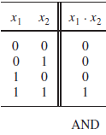
Truth Table
The previously mentioned operations ( AND, OR, complement) can also be defined in the form of a table, called truth table.
The truth table indicates the outputs for the different possibilities of the inputs.
Case: 1

Slide 17
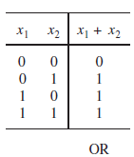
Case 2:

Slide 18
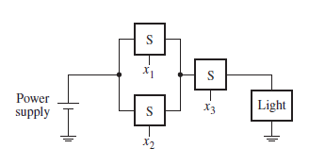
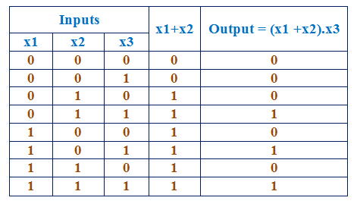
Case 3:

Slide 19
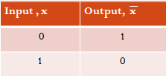
Inversion

